Slide 1
DIGITAL STRATEGY PROPOSAL
What Eric Davis can do for Bacchus' Kitchen.
Website
SEO
Content
Catering & Venue
Long-Term Growth
Eric Davis
Content & Digital Strategy
linkedin.com/in/eric-davis-4b1034b8
Notes:
Open warm. This is a proposal, not a sales pitch. Name yourself and the five things you'll cover, then move fast to the problem.

Slide 2
THE PROBLEM
Every day this does not change, money is walking out the door.
Bacchus has live jazz, a full wine bar, a $100 per month Wine Club, catering, venue rental, and gift cards. That is six revenue streams, and right now five of them are nearly invisible online. This is not a branding problem. It is a discoverability problem.
0
5 sec
68%
Catering or venue leads coming from the website today
Before a visitor decides if a site is worth staying on
Of diners research online before choosing a restaurant
Source: Local SEO for Restaurants research, 2026
Notes:
Lead with the pain. Six revenue streams, five nearly invisible online. This is a discoverability problem, not a branding one. Let the three stats land before you say a word about the solution.

Slide 3
WHO I AM
I manage digital web presence at scale for one of the largest health systems in the country, coordinating vendors, stakeholders, legal, and IT across thousands of digital properties.
Not your typical freelancer.
For Bacchus, that means you get someone who has been tested at a level most freelancers have not, working on a project he genuinely cares about.
Started at Kaiser Permanente in the call center
Worked through multiple roles over nine years
Now Program Lead over KP's entire digital web presence portfolio
9+
100s
$0
Squarespace and CMS specialist
Years at Kaiser Permanente
Digital properties managed
Wasted on things that do not work
M.S. Business Analytics candidate, CSUN Dean's Scholar
Notes:
You are not a weekend freelancer. Nine years at Kaiser, now running a digital program for one of the largest health systems in the country. Tested at a scale most freelancers never see, on a project you genuinely care about.

Slide 4
CURRENT SITE REVIEW
I reviewed the current site. Here is what is broken.
bacchuskitchen.com | Reviewed June 2026 | Built on Wix | Moving to Squarespace is part of this engagement
Hours say "midweek hours vary"
Menu is photos of printed menus
Tock reservation button is buried
A visitor who wants to come Wednesday has no idea if they can. Vague hours send people straight to a competitor.
Unreadable on mobile, invisible to Google, and the page itself admits it may not be current.
Reservations run through Tock, which is great, but the button is easy to miss on mobile. Every miss is a lost booking.
Photos do not show what this is
Nav URL is "copy-of-wine-club-1"
Copyright footer still says 2024
A first-time visitor cannot tell if this is a wine shop, fine dining, or a jazz lounge. The identity is lost in five seconds.
The Menus page URL is a leftover Wix slug nobody cleaned up. It signals to Google the page has no structure.
Small detail, big impression. An outdated footer signals to every visitor that the site is unmaintained.
Notes:
You did the homework before the meeting. Walk through two or three of these by name. The copy-of-wine-club-1 URL and the 2024 footer prove you actually looked.

Slide 5
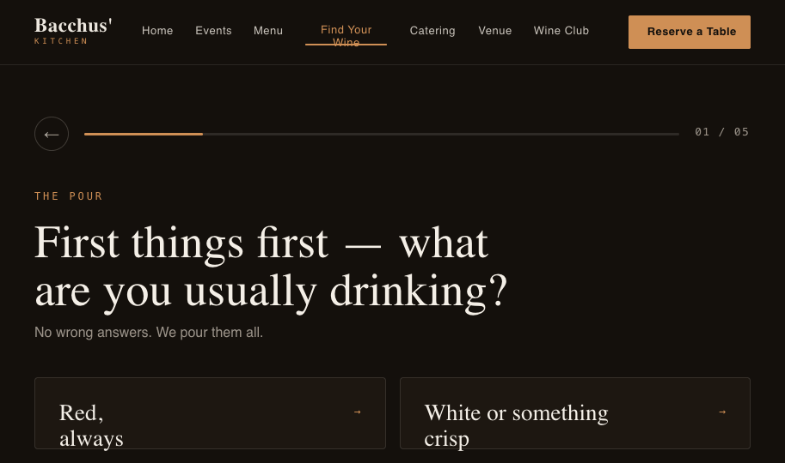
THE HOMEPAGE, REIMAGINED
What it looks like now vs. what it should be.
The right-hand preview shows the Find Your Wine page, a custom HTML quiz linked from the homepage. Built for this proposal.
CURRENT SITE
NEW SITE · BUILT & CLICKABLE
bacchuskitchen.com/copy-of-wine-club-1
bacchuskitchen.com
Home
Jazz
Picnic Menu
Catering
Menus
More
No clear identity
[ photo, unclear what this is ]
Long bio paragraph, no CTA
Events list
Wine Club hidden
© 2024 Bacchus' Kitchen
Outdated footer
Clear headline in 5 seconds
Reserve & Book the Space above the fold
Wine Club finally visible
Link to Find Your Wine quiz page
Notes:
This is the reveal. Left is roughly what they have now. Right is a real design I built for this proposal. Point out: clear headline, reservation and venue buttons above the fold, the Wine Club finally visible.

Slide 6
BUILT MOBILE-FIRST
NEW · MOBILE-FIRST
CURRENT
Most diners decide on their phone. The current site fights them.
Bacchus'
Reserve
Bacchus' Kitchen
☰
Home
Jazz
Picnic Menu
Catering
Win…
Unclear
[ photo ]
LIVE JAZZ · CURATED WINE
An intimate night of jazz & wine.
Roughly 68% of restaurant searches happen on mobile. Today the phone experience is the worst version of Bacchus. The new site flips that, so the phone becomes the strongest channel, not the weakest.
Bacchus' Kitchen is a restaurant and wine bar. Chef Claud has a long background that goes here in a dense paragraph with no clear next step for the visitor to take…
Book a Table
reserve a table
Hard to tap
Book the Space
SAT JUL 12
Reserve
NOW
NEW
Brandon Coleman Trio
Cramped nav, tiny tap targets
Reserve on every screen, thumb-friendly
Wine Club
Menu is unreadable photos of paper
$100/mo · 3 bottles · 6 perks
Join
Reserve button buried and hard to tap
Real text menu, readable and indexed
Stacked, fast, photo-forward layout
© 2024 Bacchus
Outdated
Notes:
Most diners are deciding on their phone. The current mobile site is the worst version of the experience: cramped nav, a menu that is photos of paper, and a reservation button that is hard to even tap. The new site is built mobile-first, so the phone becomes the strongest channel instead of the weakest.

Slide 7
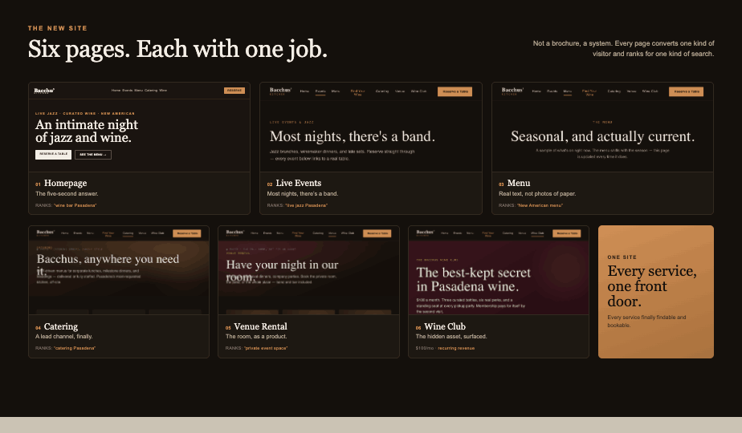

Slide 8
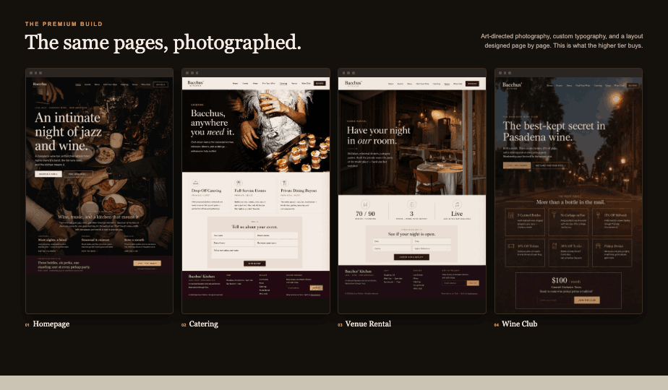

Slide 9
THE HIDDEN ASSET
The Wine Club is already a competitive advantage.
A $100 per month club with real perks, barely promoted and almost invisible to anyone who does not already know about it. That is a missed revenue and retention tool, sitting in plain sight.
3 Curated Bottles
No Corkage on 1
15% Off Midweek
Handpicked monthly. Boutique wines not in grocery stores.
Bring a bottle from the three-pack, corkage waived.
Drives repeat Tuesday-through-Thursday visits.
10% Off Tickets
30% Off To-Go
Pickup Parties
A standing reason to fill seats at jazz nights.
Encourages bottle sales outside of dining visits.
An exclusive in-person perk that builds loyalty.
What I will do · Give the Wine Club its own homepage section, a dedicated signup flow, and SEO copy so it shows up when people search for wine clubs in Pasadena.
Notes:
The Wine Club already exists with real perks and is almost invisible online. No competitor has one. Give it a homepage section, a signup flow, and SEO, and it becomes a discovery and retention engine.

Slide 10
ONE SITE, SIX REVENUE STREAMS
Every service finally has a digital front door.
Right now these streams exist but operate in silos. The site does not connect them. The new one gives each one a clear path, so a visitor who comes for jazz can also discover the Wine Club or inquire about the space.
Dinner Reservations
Jazz & Live Events
Wine Club
Tock button on every page · clear hours and current menu · frictionless path to book
Dedicated calendar · ticket and reservation links · designed to drive repeat visits
$100 per month recurring · signup flow on homepage · SEO for "wine club Pasadena"
Catering
Venue Rental
Gift Cards
Dedicated page · inquiry form with lead capture · SEO for "catering Pasadena"
Capacity and layout details · photo gallery · inquiry form for bookings
Promoted on homepage · natural upsell after events · passive revenue opportunity year-round
A visitor looking for a jazz night could discover the Wine Club, or inquire about booking the space for a birthday dinner. The site makes that path possible, Bacchus still has to close it.
Notes:
Today these streams operate in silos. A diner has no idea there's a Wine Club; a jazz guest has no idea they can book the space. The new site connects all six so one visitor can convert across several.

Slide 11
PRICING IN CONTEXT
Priced right. Just not findable.
The problem is not the product or the price. It is that nobody can find it. Here is how Bacchus compares to the market.
JAZZ EVENTS & COVER
WINE CLUB MEMBERSHIPS
Vibrato, Bel Air
$30 to $60+
Typical LA-area club
$50 to $150
Higher end, Herb Alpert's venue
Usually 2 bottles, fewer perks
Catalina Jazz Club
$10 to $30 + min.
The Cellar, Pasadena
2-bottle min.
One of LA's priciest, per Time Out
No formal membership structure
Bacchus' Kitchen
$45 to $65
Bacchus Wine Club
$100 / month
Competitive with the neighborhood
3 bottles + 6 perks
The takeaway: Bacchus is priced right. Neither the events nor the club need a price cut. They need to be findable.
Notes:
The pricing is not the problem. Show that Bacchus sits right in the market for both events and the Wine Club. Neither needs a price cut. They need to be findable.

Slide 12
THE OPPORTUNITY
Nobody owns the lane Bacchus can own.
Vibrato
Catalina
Blue Note LA
Bacchus'
Local Search Visibility
Strong
Strong
Very Strong
Not Yet
Mobile Site
Yes
Partial
Yes
Needs Work
Clear Brand Identity
Yes
Yes
Yes
Untapped
Catering & Venue Rental
Limited
No
No
Yes, but Hidden
Wine Club or Loyalty Perk
No
No
No
YES
Bacchus is the only one with a Wine Club. That is a loyalty and discovery tool no competitor has, and right now nobody outside of existing members knows it exists.
Notes:
None of the bigger venues own the neighborhood, intimate, all-in-one angle online. And Bacchus is the only one with a Wine Club. That is the open lane.

Slide 13
REAL CASE STUDY
An example of what visibility can do.
Italian restaurant, Lincoln Park, Chicago. Not showing up in Google for "Italian restaurant Lincoln Park" or "dinner near me." Walk-in traffic only, no Google Business Profile, no on-page SEO.
What they did: optimized the Google Business Profile, rewrote on-page SEO, added neighborhood keywords, and built a review generation strategy.
+312%
90
6 mo
Increase in direction requests from Google after SEO improvements
Days to see measurable results
To reach full ranking potential
Source: Flento Local SEO Case Studies, 2026 · flento.io/blog/local-seo-case-study
Notes:
This is not guesswork. A Chicago Italian restaurant with the same starting conditions optimized its profile and on-page SEO and saw a 312% jump in direction requests. The playbook exists; it just needs to be executed here.

Slide 14
SEO STRATEGY
Targeting searches that bring in revenue.
Keywords identified with SEMRush to capture reservations, catering leads, venue bookings, and Wine Club signups, across Pasadena and the wider Eastside of LA.
Jazz & Nightlife
Dining & Wine
Catering
Venue Rental
live jazz Pasadena jazz bar Glendale jazz club Los Angeles live music Eastside LA wine and jazz San Gabriel Valley
wine bar Pasadena wine bar Glendale date night restaurant Burbank intimate dining San Gabriel Valley wine club Los Angeles
catering Pasadena CA catering San Gabriel Valley corporate catering Glendale event catering Burbank private catering Los Angeles
event venue Pasadena private event space Glendale venue rental San Gabriel Valley party venue Burbank small event space Los Angeles
GEOGRAPHIC REACH
Pasadena
Glendale
Burbank
La Cañada
Monrovia
San Gabriel Valley
the Valleys
Timeline: results typically take three to six months as Google indexes the new site and content builds local authority across the Eastside.
Notes:
Keywords found with SEMRush, grouped by the revenue they bring in. The strategy is not just Pasadena. We target the wider Eastside of LA: Glendale, Burbank, La Canada, Monrovia, and the San Gabriel Valley, where catering and venue searches are less contested. Results take three to six months as Google indexes the new site and content builds authority.

Slide 15
RESTAURANT-SPECIFIC DETAILS
The things that will make or break this.
Most freelancers do not bring these up. I am bringing them up now so there are no surprises.
Reviews Strategy
Photography Direction
Online Reservations (Tock)
Google and Yelp reviews are a major ranking signal. I will build a simple process for earning them after a visit.
Photos exist but do not sell the experience. The engagement includes a shot list so future photos do.
Bacchus already uses Tock. I will make the button prominent on every page and on mobile.
Menu Overhaul
Accessibility (ADA)
Scope & Contract
The current menu is photos of paper that may not be current. The new one is real text, mobile-ready, and maintained.
Squarespace has built-in tools. I will enable alt text, ensure color contrast, and add keyboard navigation.
A simple one-page contract before work starts. It protects both of us on what is included and what is additional. If you choose not to continue with a retainer, the engagement includes a warm handoff to whoever manages the site going forward, with basic training on how to make updates.
Notes:
Most freelancers don't raise these. You are, up front, so there are no surprises: reviews, photography, Tock, the menu, ADA, and a simple contract.

Slide 16
BEFORE I BUILD ANYTHING
I have questions about your brand.
The best websites are built on clarity. Before design starts, I need to understand who Bacchus is for and what it stands for.
01
Who is your ideal customer?
02
How should people feel walking in?
Date-night couples? Corporate clients? Jazz enthusiasts? This shapes every decision.
Upscale? Neighborhood-warm? Electric? The brand should make them feel it before they arrive.
03
What makes Bacchus different?
04
How much comes from catering and venue?
The music? The wine list? Chef Claud's story? The one thing a visitor should remember.
Primary goal or secondary? This determines how much weight it gets in the site.
05
How do you want to grow the Wine Club?
06
Who handles photos and content going forward?
Grow membership, or retain regulars? This sets how prominently it is featured.
You? A staff member? Or me, ongoing as part of a retainer?
Notes:
The best sites are built on clarity. Before design starts, you need answers to these. Ask them in the room, or leave them as homework.

Slide 17
WHAT BETTER VISIBILITY COULD MEAN
What the numbers could look like.
Based on Bacchus's actual 70-seat capacity. Currently there are zero digital leads for catering or venue rental.
Jazz Night Revenue
Catering Revenue
Venue Rental Revenue
70 seats · 4 events per month ~$45 per person (cover + drinks)
Currently zero digital leads Avg booking $2,000 to $5,000
Not promoted online at all $500 to $1,500 per event
~$8,800/mo
$4k to $10k/mo
2 to 4bookings/mo
Conservative 70% fill. Full sell-out ≈ $12,600.
From even 2 bookings a month. A dedicated page and SEO make that possible.
A venue page and inquiry form opens a new lead channel.
Notes:
Realistic numbers based on the actual 70-seat capacity. Today there are zero digital leads for catering or venue. These are goals, not promises, but they show the size of the prize.

Slide 18
THE PLAN
A realistic six-month roadmap.
Results build over time, not overnight.
01
02
03
Weeks 1 to 4
Weeks 5 to 6
Months 2 to 6
Foundation
Visibility
Results
New Squarespace site built Home, Events, Catering, Venue, Menu Tock button on every page Google Business Profile set up Specific hours, menu as text
SEMRush keyword research On-page SEO for all pages Meta titles, descriptions, sitemap Events calendar live with real dates Catering and venue forms active
Monthly content and event updates Google indexing and ranking builds Catering and venue leads come in Wine Club signups increase SEO performance review monthly
Notes:
A realistic six-month roadmap. Results build over time, not overnight. Foundation, then visibility, then results.

Slide 19
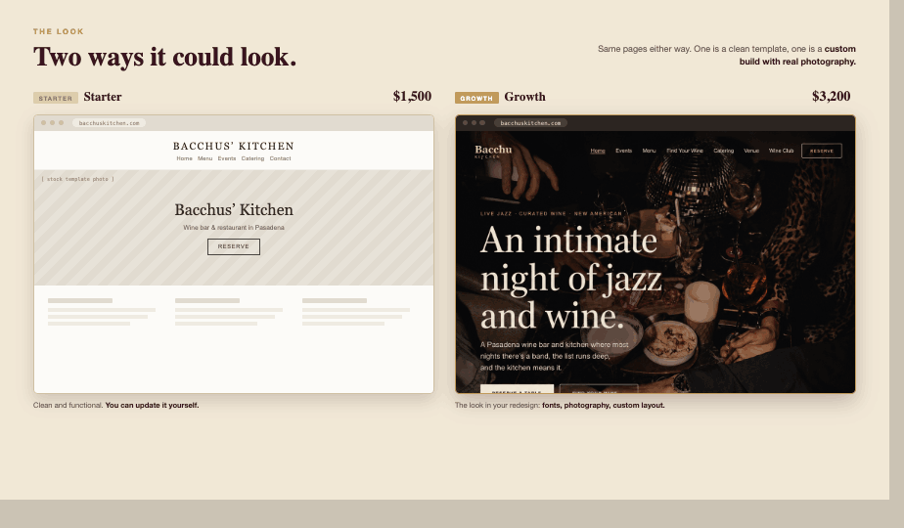

Slide 20
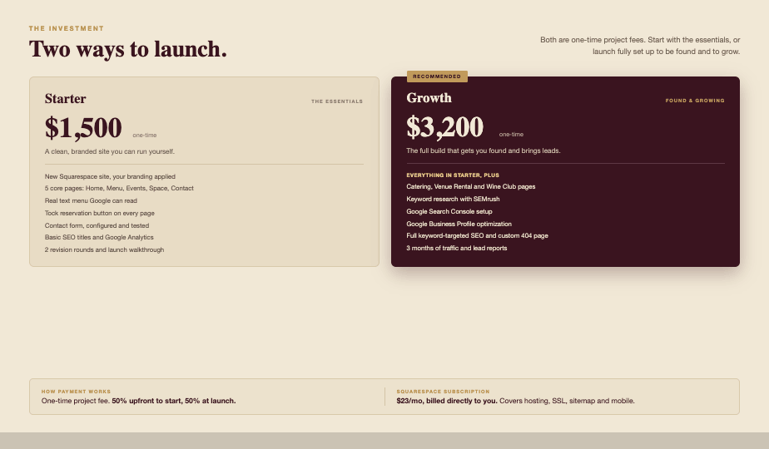

Slide 21
BEYOND THE BUILD
Add-ons that keep the site earning.
Squarespace does far more than host a homepage. Each of these is either a new revenue stream for Bacchus or a recurring line for me. Suggested ranges, layered on as the site grows.
ONE-TIME BUILDS
RECURRING · MONTHLY
Online Store
+$400 to $800
Email Marketing
+$150 to $300
Gift cards, to-go bottles, branded merch
Monthly newsletter + event blasts
Wine Club Member Area
+$500 to $900
Blog & Content SEO
+$200 to $400
Gated member pages, exclusive content, Wine Club perks
Chef stories, event recaps, seasonal posts
Scheduling (Acuity)
+$250 to $500
Analytics & Reporting
+$75 to $150
Private dining, tastings, catering consults (Acuity subscription ~$16 to $49/mo separate)
Monthly traffic and booking dashboard
Event Ticketing
+$250 to $450
Seasonal Refreshes
+$100 to $250
Paid jazz-night tickets, sold on-site
Menu, photos, and event calendar upkeep
Email + Domain Setup
+$150 to $300
Social Content
+$200 to $400
Professional email on the bacchus domain
Instagram feed + scheduled posts
Start with the build. Layer these in as Bacchus grows, each one pays for itself.
Notes:
Frame this as the growth menu. The build is the foundation; these are the levers. Each one is either a new revenue stream for Bacchus or a recurring line for me. One-time builds on the left, monthly add-ons on the right. Suggested ranges, all negotiable, all on top of the core package.

Slide 22
LET'S MAKE IT HAPPEN
Bacchus deserves to be found by the people looking for it.
1
2
3
4
We agree on scope
I send contract and invoice
Phase 1 site live within 45 days
Full site and SEO within 60 days
Eric Davis
[email protected] · linkedin.com/in/eric-davis-4b1034b8
Notes:
Land it warm and direct. We agree on scope, you get a contract and invoice, Phase 1 is live within 45 days, full site and SEO within 60. Then your contact.

